Slide 1
Lab Leak

Slide 2
IDA pro
https://drive.google.com/file/d/0B5w3KuqR3zoBZVk2SmR0NVJ6X2c/view

Slide 3
題目要求
Leak
1. Canary
2. Stack
3. PIE
4. Libc
5. Secret
Leak all and get flag.

Slide 4
0x0
PIE Base
Text
Bss
Heap Base
Heap
Libc Base
Libc.so
ld.so
Stack Base
Stack
0xffffffffffffffff

Slide 5


PIE Example
Command line :readelf -a leak | grep main
0x1b5f -> relative position from PIE base
Real position
Real position = PIE Base + 0x1b5f

Slide 6
Libc Example
Command line :readelf -a libc.so.6 | grep system
0x52fd0 -> relative position from Libc base
Real position
vmmap
Real position = Libc Base + 0x52fd0

Slide 7
Canary
Local Variable
Buf
Stack Frame
Canary(0xfaceboocboocface)
Old Rbp
Return Address

Slide 8
Canary
If Buf can buffer overflow
Input lots of ‘A’
Local Variable
Buf
Canary(0xfaceboocboocface)
Old Rbp
Return Address

Slide 9
Canary
Before return, it will check canary value is correct or not
0x4141414141414141 != 0xfaceboocboocface
Stack smash detect -> abort
Local Variable
AAAAAAA……
Canary(0xfaceboocboocface)
Old Rbp
Return Address

Slide 10
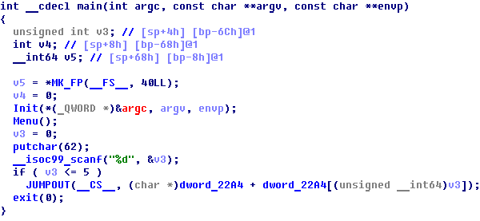
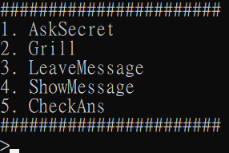
This time no source code, just binary
Need a little bit reverse
Use IDA to decompile

Slide 11
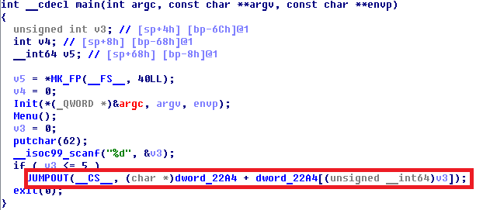
Jump table is hard to reverse
Switch case use jump table to calculate the jump address.

Slide 12
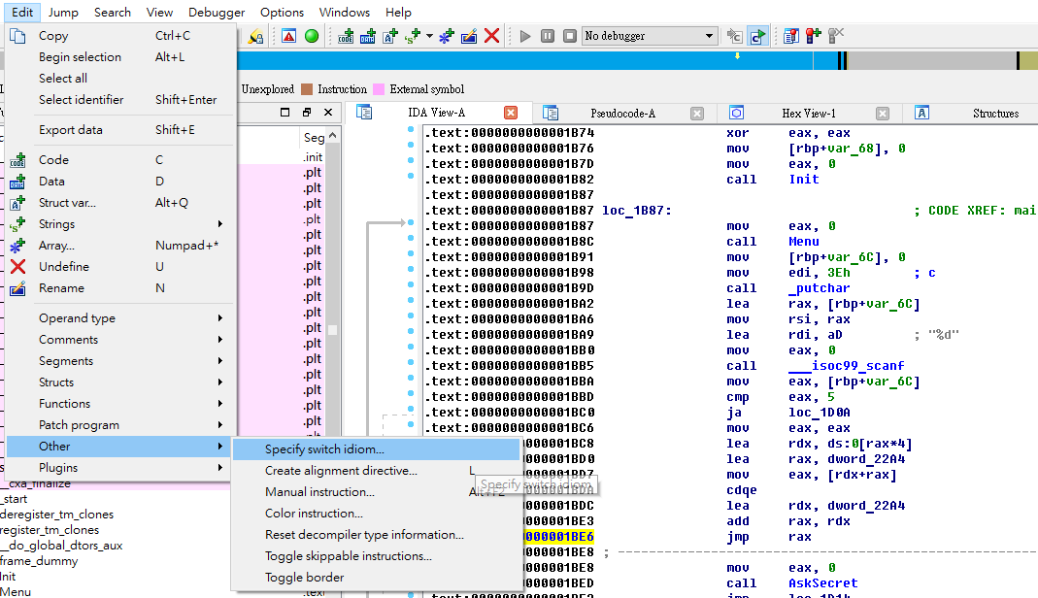
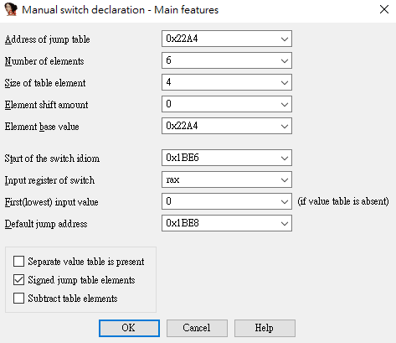

Slide 13
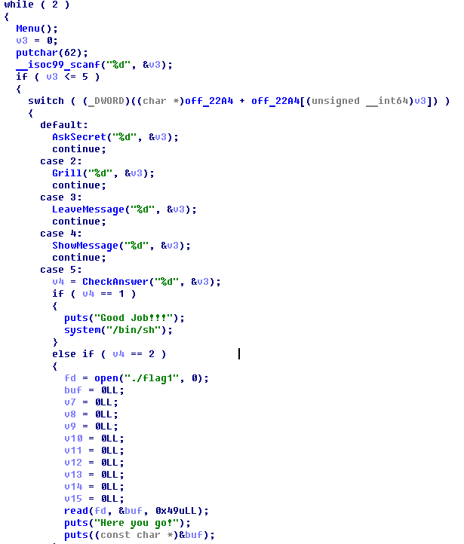

Slide 14
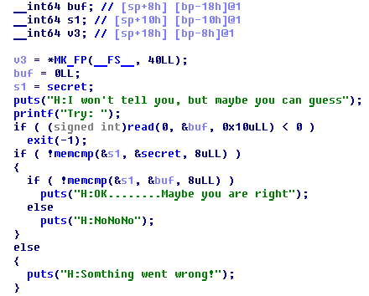
Secret
Secret is a random value.
1. Store secret in stack s1.
2. Read input in buf
3. Compare s1 with secret, check they are the same.
4. Compare s1 with buf, check they are the same.

Slide 15
Secret
1.Buf size is 8 byte
2.Read 0x10 byte, so we can overflow s1.
3.We can partial overwrite s1 and check the output
Is “NoNoNo” or “Something went wrong”

Slide 16
Secret
Secret = 0x1122334455667788
buf
88 | 77 | 66 | 55 | 44 | 33 | 22 | 11

Slide 17
Secret
Secret = 0x1122334455667788
Oveflow with 0x41
Output will be “Something went wrong”
AAAAA….
41 | 77 | 66 | 55 | 44 | 33 | 22 | 11

Slide 18
Secret
Secret = 0x1122334455667788
Oveflow with ‘0x88’
Output will be “NoNoNo”
So we know first byte of secret is 0x88
And we can test next byte of secret
AAAAA….
88 | 77 | 66 | 55 | 44 | 33 | 22 | 11

Slide 19
Secret
Worst case 256*8 = 2048 will leak all secret

Slide 20
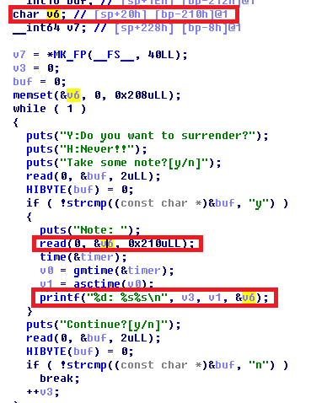
Canary and Stack
V6 size 0x208, read 0x210
Overflow canary

Slide 21
Canary and Stack
Canary = 0x1122334455667700
Last byte must be 0x00
AAAAA….
00 | 77 | 66 | 55 | 44 | 33 | 22 | 11
Old Rbp

Slide 22
Canary and Stack
Canary = 0x1122334455667700
Now printf(“%s”,v6)
“AAAAA…” + “\x77\x66\x55….” + Old RBP
Leak Canary and Stack!!!
P.S:
Need overflow again and make first byte of Canary
To be 0x00, otherwise stack smash detect
AAAAA….
41 | 77 | 66 | 55 | 44 | 33 | 22 | 11
Old Rbp

Slide 23
Homework Hint
Use Grill + Leave Message + Show Message
It’s about stack frame

Slide 24
Function1
Function2
‘\x00’*0x300
Buffer1
‘A’*0x10
Buffer2
Uninitialize local variable

Slide 25
Function1
Function2
‘\x00’*0x300
Buffer1
‘A’*0x10
Buffer2
Strlen(Buffer2) = 0x10
‘\x00\x00\x00’……
Uninitialize local variable

Slide 26
Function1
Function2
‘A’*0x300
Buffer1
‘A’*0x10
Buffer2
Uninitialize local variable

Slide 27
Function1
Function2
‘A’*0x300
Buffer1
‘A’*0x10
Buffer2
Strlen(Buffer2) >= 0x300
‘A’……
Uninitialize local variable

Slide 28
Have Fun!!

